Slide 1
Head direction network

Slide 2
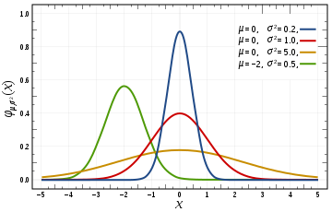
Parameters
N_ex = 180
N_in = N_ex
N_cj = N_ex
sigma = 0.12
mu = 0.5
delay = 0.1
base_ex = 4000
base_in = 450
base_cj = 169
w_ex_cj = 660
I_init = 300.0 #pA
I_init_dur = 100.0 #ms
I_init_pos = N_ex//2
Number of cell in each population
Parameters for describing connection weights between populations
size , duration and excitatory cell number to initialize the bump

Slide 3
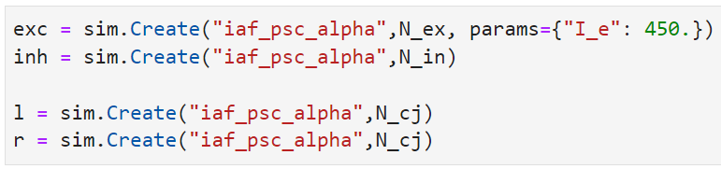
Create populations
Continuous current input to excitatory population produces spontaneous firing which keeps the bump going
One of many default cell types described in NEST, this is the basic cell type used in example networks etc
Basic leaky integrate and fire neuron

Slide 4
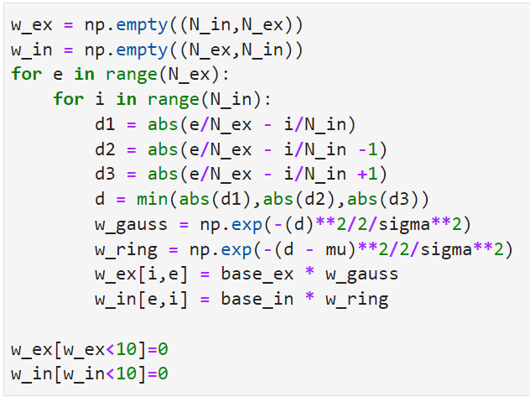
Creating the bump (connections between excitatory and inhibitory populations)
Cycle through all pairs of excitatory and inhibitory cells
Find distance between the excitatory and inhibitory cell also looking both ways around the ring
Using the smallest distance (magnitude only)
Connection weights dependant on distance
Mu term offsets the gaussian -> strong weights either side of the equivalent excitatory cell
Set small values to 0

Slide 5
Creating the bump
Create a step_current_generator device which steps up to 300pA at time 0.1 and down 100ms later
Connect this to a cell in the exc population which becomes the initial center of the bump
Note: sim.connect requires a list of cell numbers even if it is a single element list

Slide 6
Simple HD circuit using Excitatory-inhibitory attractor network
Excitatory cells fire spontaneously
More energy is injected into one cell to initialize the bump
Inhibitory limits the spontaneous activity of the excitatory cells
At the bump center inhibitory input is lowest, so excitatory cells in the bump location continue to fire
exc
inh

Slide 7
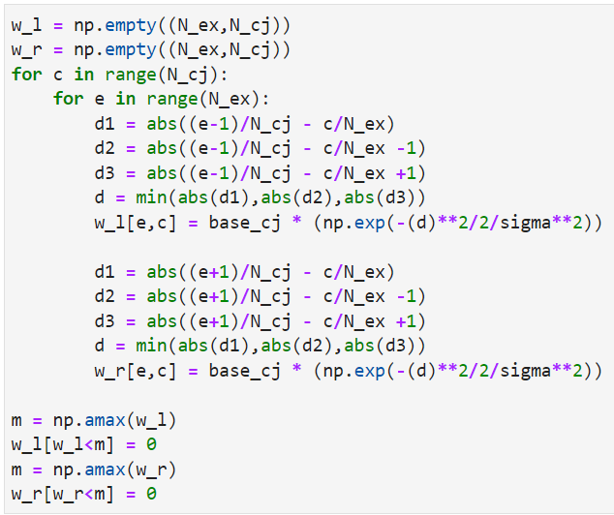
Ideothetic input (weights from conjunctive cells to exc population)
Honestly this is legacy code and could be implemented a lot simpler. Currently calculates weight based on distance like the exc-inh pops
Here the excitatory cell is offset by +1 or -1 around the ring when calculating the distance
Then just the peak connection weight is maintained
Each cell is connected to one cell one step CW or ACW around the ring
Need to specify weight 0 for all the other cell pairs - still need full weight matrix

Slide 8
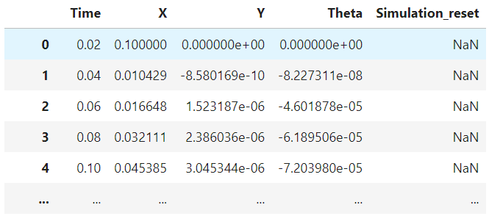
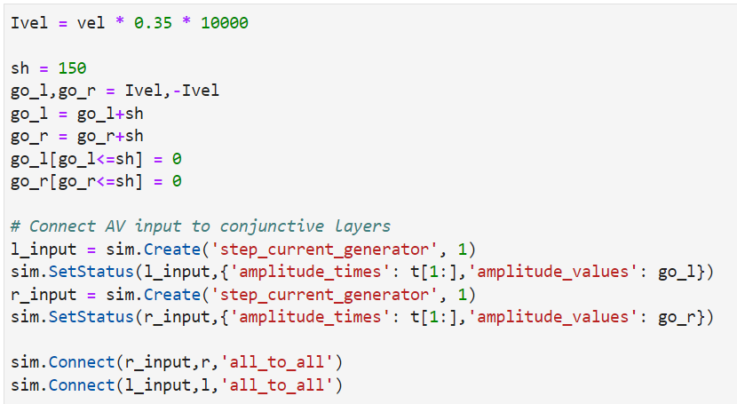
Ideothetic input (AHV from head_angle.csv or head_pose.csv)
These files saved by the transfer function have a regular 50Hz sample rate
Time must be converted to ms
Vel is the difference between theta samples
Positive values are funneled to go_l and negative to go_r
step_current _generator used again to set the current to these ‘Ivel’ values at each timestep
Current input is sent to all conj cells

Slide 9
Simple HD circuit - moving the activity bump
Go anti- clockwise input based on head angular velocity (“vestibular”/odometry input)
ACW
exc
CW
inh

Slide 10
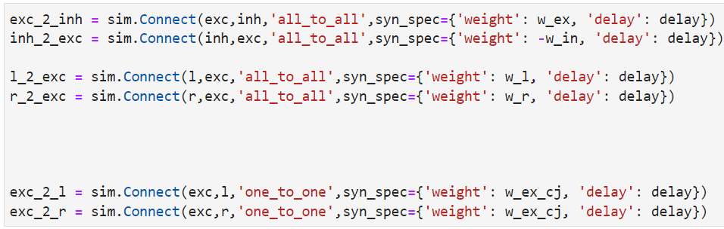
Connecting populations
Weight matrices define connections between each pair of cells in the two populaitons
Each excitatory cell is connected to its equivalent conj cell one to one with a set weight

Slide 11
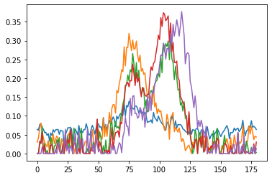
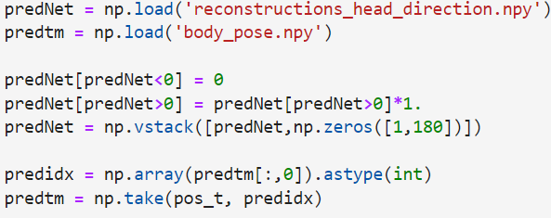
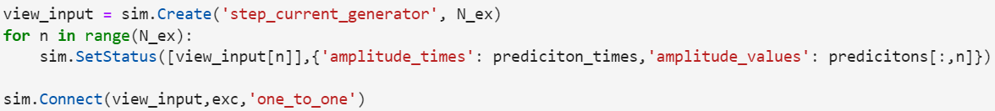
Allothetic input
Using reconstructions_head_direction.npy and body_pose.npy
Make sure predictions are all positive + option to scale predicitons
Get relative index each prediction occurs at, and find the time each prediction occurred
One step current generator per excitatory cell, use the value of the prediction at each time step as current input to each cell

Slide 12
Recording spikes
Set the folder and data prefix if saving spikes to file
Can also just store in variable

Slide 13


Run simulation
Must reset kernel between every new simulation
Either all at once
Or in chunks

Slide 14
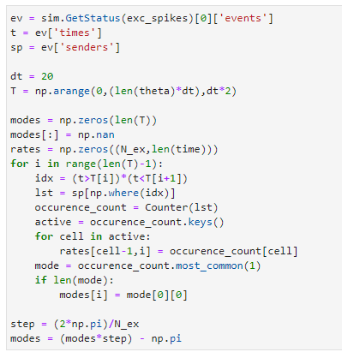
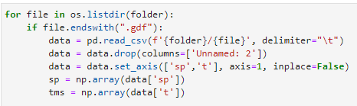
Finding the center of the bump
For spikes stores in variable
40ms bins
Find all spikes in the bin
Read spike data in from file
Find the most active cell
Find the most active cell
Convert to radians

Slide 15
Grid cell network
Only including parts that are different

Slide 16

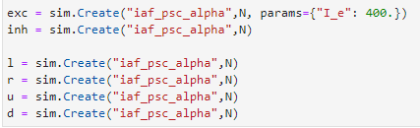
Parameters
Populations
Y_dim is a parameter used to produce the twisted torus connectivity described in Guanella et al 2007
Cells are arranged in a sheet x by y cells
Four conj populations this time to traverse the 2D sheed rather than 1D ring

Slide 17
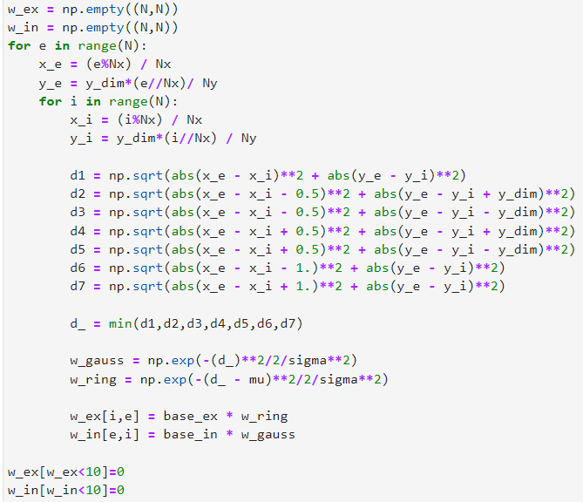
Creating the bump (connections between excitatory and inhibitory populations)
Cycle through all pairs of excitatory and inhibitory cells finding the xy position of each cell in the sheet
Find distance between the excitatory and inhibitory cell
See Guanella et al 2007 for full description of calculating the distances between cells in the twisted torus
Using the smallest distance (magnitude only)
Connection weights dependant on distance (gaussian function)
Mu term offsets the gaussian -> strong weights in a ring around equivalent excitatory cell
Set small values to 0

Slide 18
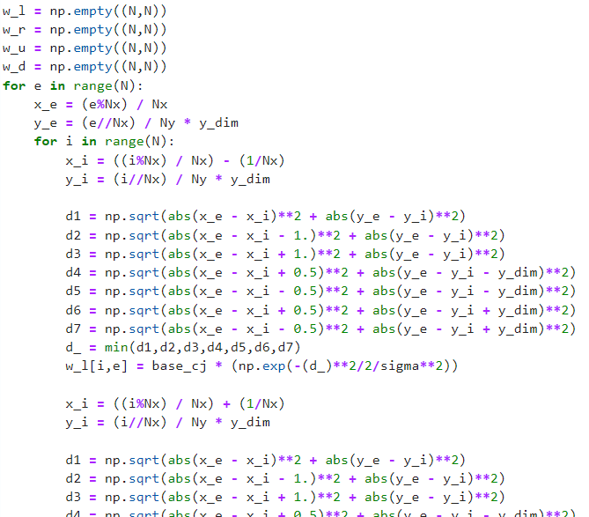
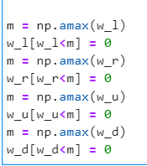
Ideothetic input (weights from conjunctive cells to exc population)
The twisted torus is needed to calculate the connections from the conjunctive layers to the exc cells.
Same calculation as exc to inh but take the max weights only

Slide 19
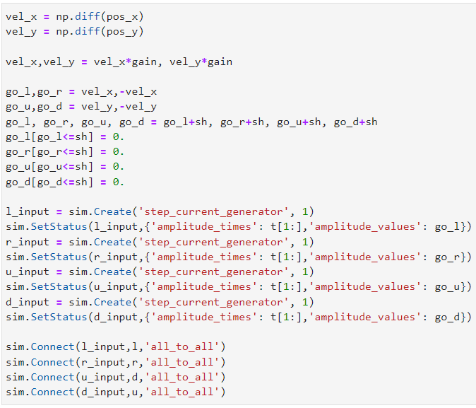
Ideothetic input (velocity samples at 50hz)
Posx posy and Time from datafile
Scale to match appropriate current values
Positive x values are funneled to go_l and negative x to go_r
Positive y values are funneled to go_u and negative y to go_d
step_current _generator used again to set the current to these ‘Ivel’ values at each timestep
Current input is sent to all conj cells

Slide 20
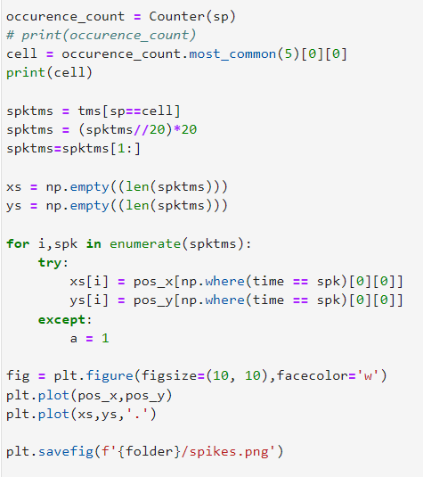
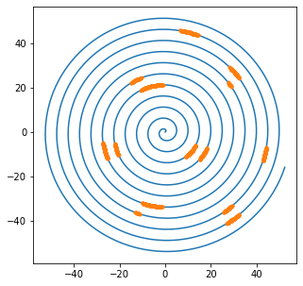
Plotting spikes on trajectory
Plot cell that spikes the most
Find spike times of that cell
Find position at each spike time
Plot spikes at these positions on the trajectory

Slide 21
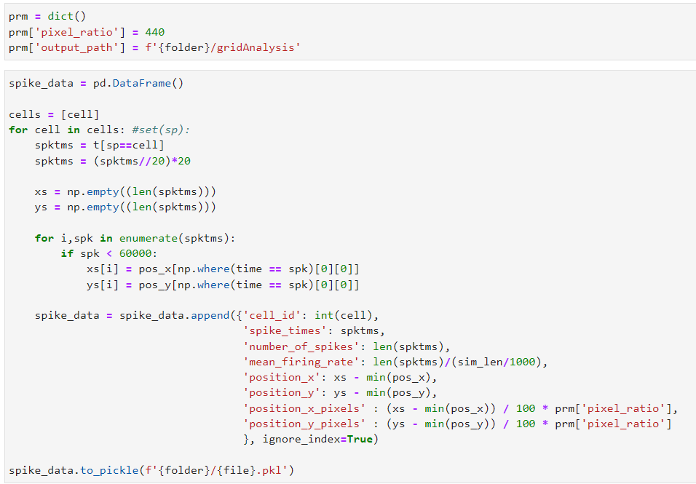
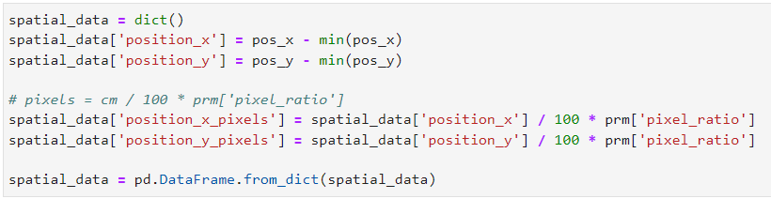
Grid analysis (uses code from Nolan group in Edinburgh available on GitHub)
Requires data to be arranged in a very specific format

Slide 22
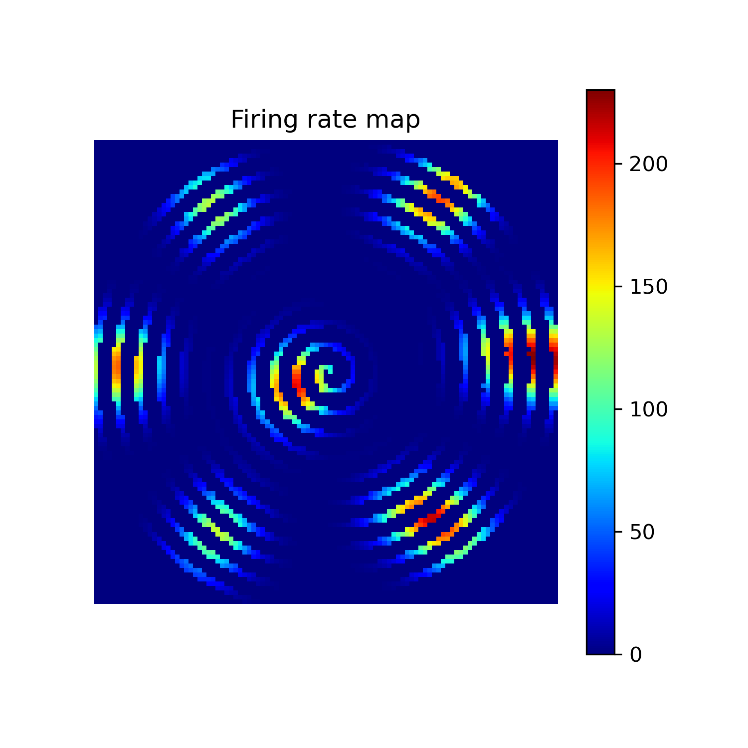
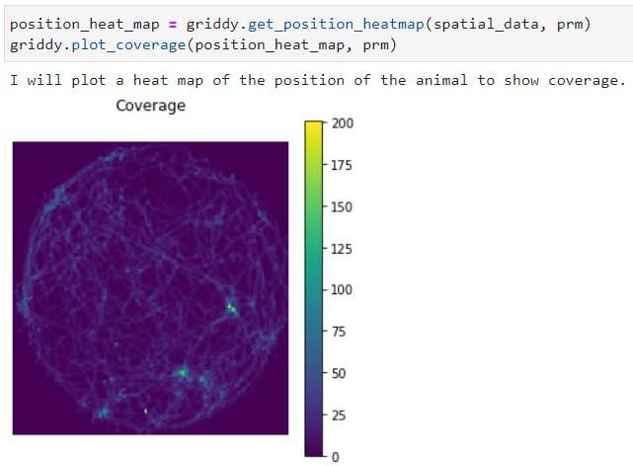
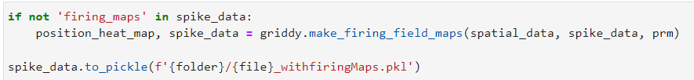


Grid analysis (uses code from Nolan group in Edinburgh available on GitHub)
Ive put all of the adapted functions in a single file

